Slide 1
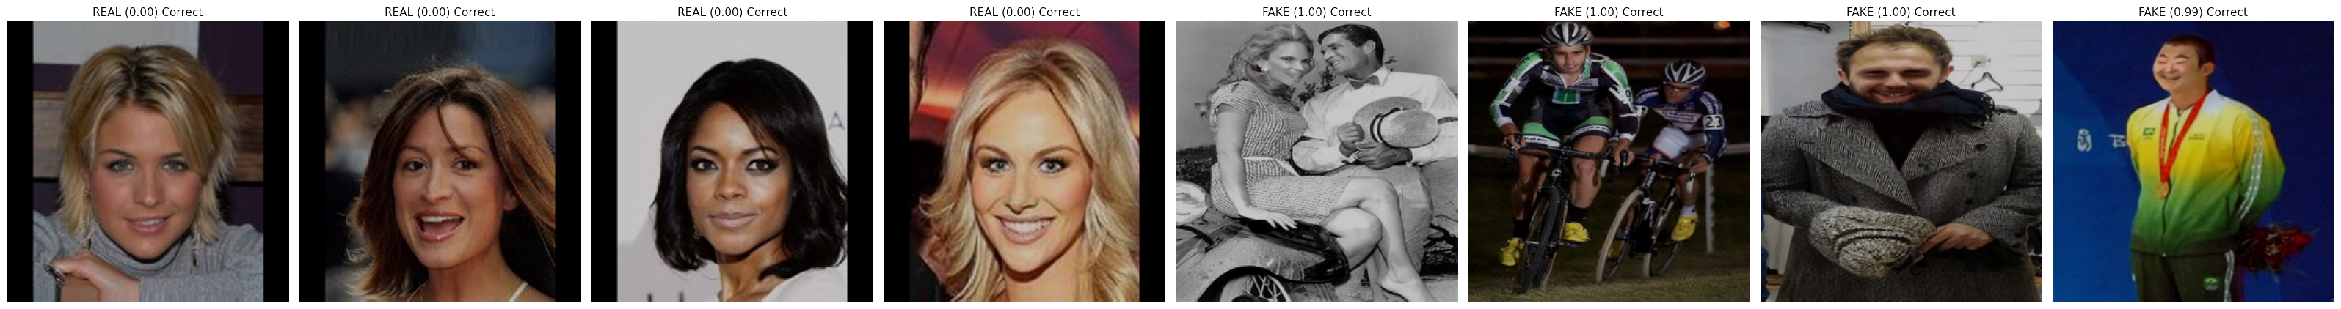
UnFooled: Attack‑Aware Deepfake & Image Forensics
Noor Fatima, Muzammil Behzad — KFUPM

Slide 2
Agenda
Motivation & Problem
Research paradigm
Method (architecture + training/testing)
Datasets & protocol
Metrics
Results
Contributions, limitations, future work

Slide 3
Motivation: Why this matters
Deepfakes impact journalism, governance, legal workflows.
Detectors degrade after routine platform handling (recompress/resize) & counter‑forensics.
Beyond a label, analysts need where the evidence is.
Goal: stable, calibrated decisions + auditable heatmaps under realistic stress.
Artifacts aren’t fixed properties—they change once adversaries know what we look for.

Slide 4
Problem Statement & Threat Model
Task: (a) Real vs Fake; (b) Weak localization (heatmap) after attacker edits.
Attacks: jpeg (realign + recompress), warp (subpixel resampling), regrain (denoise then add synthetic grain), seam (boundary smoothing), gamma (mild tone mapping), and transcode (social-app–style re-encoding).
Constraint: Edits keep content plausible; aim to suppress/spoof forensics.
We evaluate on clean vs attacked versions of the same content; worst‑case behavior matters.

Slide 5
Research Questions (RQs) & Goals (RGs)
RQ1: Which counter‑forensics hurt most?
RQ2: Do attack‑aware training + Test-Time Augmentation improve worst‑case robustness & calibration?
RQ3: Does fusing content + residuals help when one cue is weakened?

Slide 6
Research Paradigm
Paradigm: Design & construction of a two‑stream detector + experimental evaluation under realistic stress.
Formalization: Losses/objective for robustness & weak localization.
A deployment-oriented detector that is robust under realistic counter-forensics, calibrated for decision-making, and able to surface spatial evidence with weak supervision.

Slide 7
Related Work
Datasets/protocols: FaceForensics++, DFDC (compression‑aware).
Detectors: semantic (Xception), boundary (Face X‑ray), frequency (F3‑Net), generic localizers (ManTra‑Net).
Defenses: randomized input transforms; counter‑forensics increasingly practical.
These advances don’t consistently report worst‑case robustness, calibration, or provide weakly‑supervised evidence maps.

Slide 8
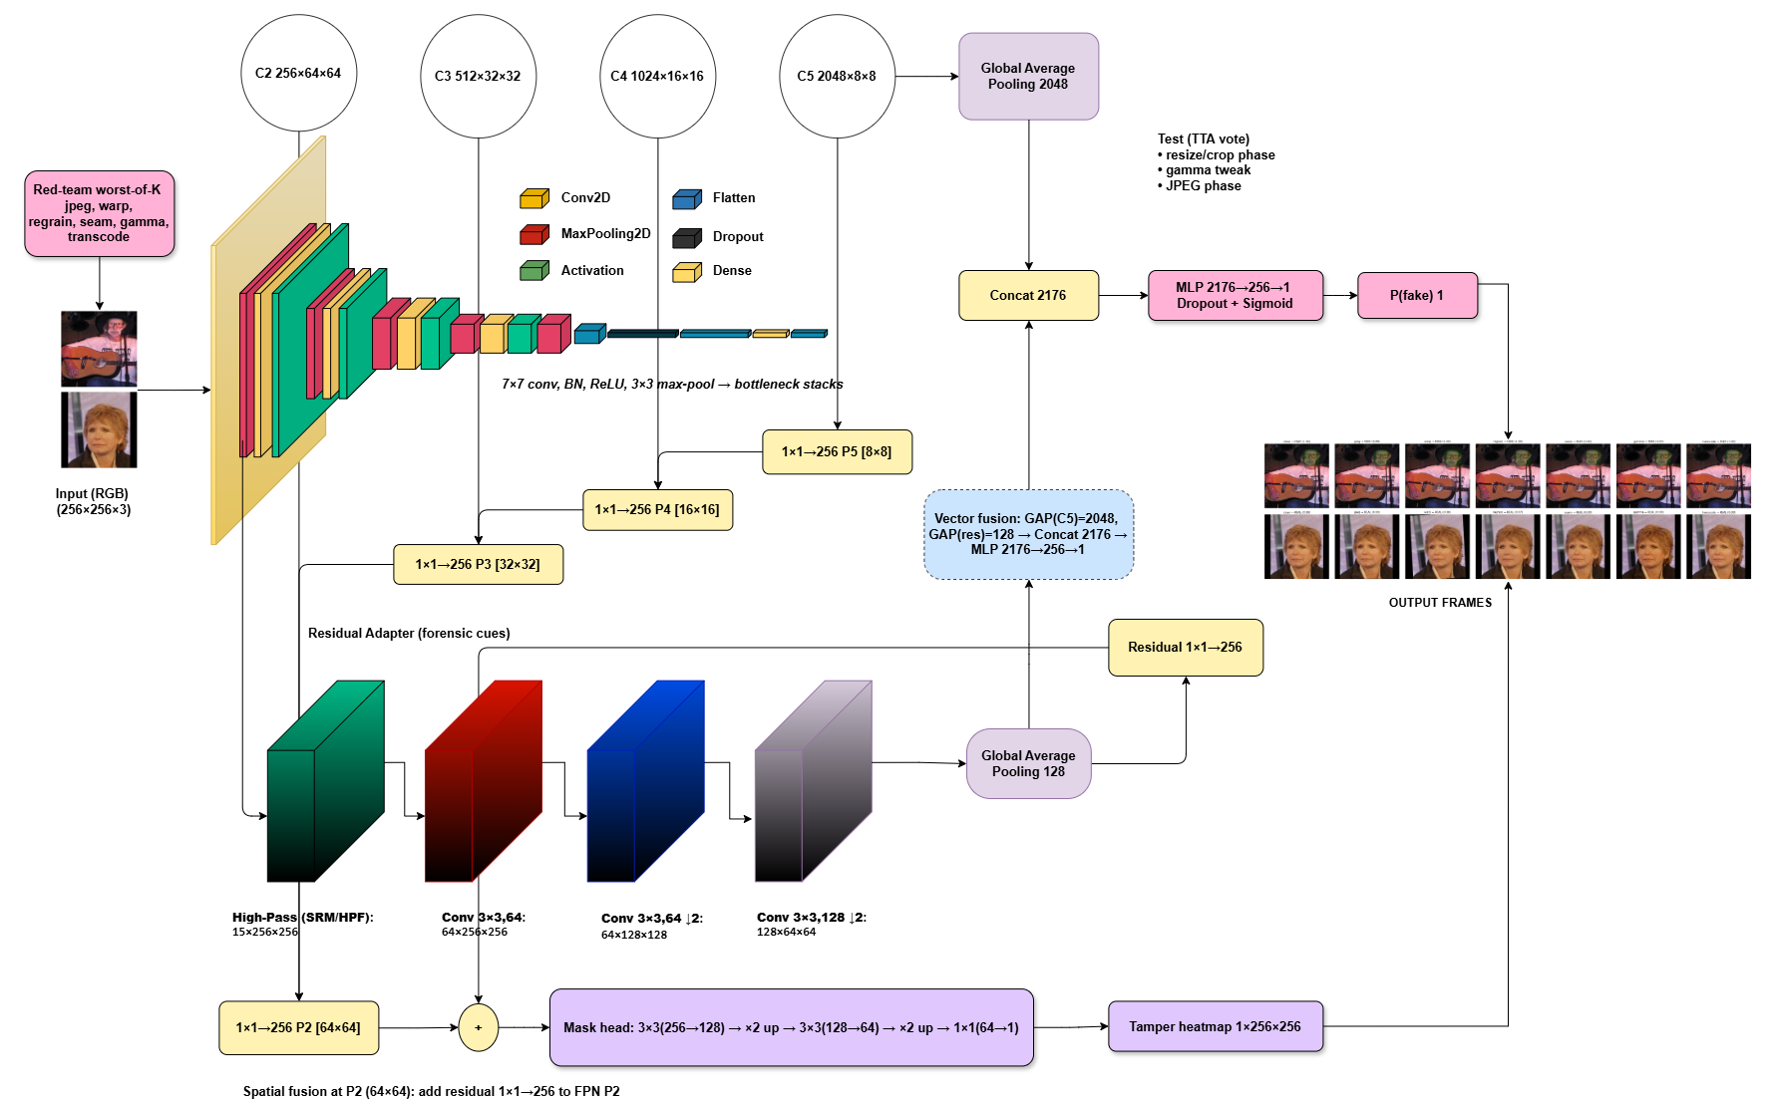
System Architecture

Slide 9
Method Overview
UnFooled is a two-stream, attack-aware detector.
The Content Stream extracts semantic/content features with a collapsed ResNet-50 and makes the real/fake decision.
The Residual stream extracts forensic residual cues (high-frequency traces). Forensic branch fed by SRM/HPF (high-pass/Spatial Rich Model filters) + a small CNN to emphasize noise/edge artifacts rather than content.
Injects them into a light FPN (Feature Pyramid Network) style mask head to produce a tamper heatmap.
Training uses worst-of-K red-team attacks; testing uses randomized TTA (resize‑phase, gamma, JPEG phase) with voting.

Slide 10
Method
Input → Red-team (train): For each image, apply the hardest of jpeg/ warp/ regrain/ seam/ gamma/ transcode (worst-of-K).
Two streams: Content (ResNet-50): C5 → GAP 2048 → concat; contributes semantics for the decision. Residual (SRM/HPF + small CNN): 128×64×64 → GAP 128 (for decision) and 1×1→256 P2 (for mask).
Fusion & head: Concat 2176 (=2048+128) → MLP(256) → P(fake).
FPN mask head: P5→P2 top-down; residual injected at P2; 3×3 + upsampling → 1×256×256 tamper heatmap.
Test-time (TTA): small resize-phase, gamma, JPEG phase jitters; logit-mean for class prob, max/mean for heatmap.

Slide 11
Method cont.
Classification: BCEWithLogits (on the image-level fake/real logit).
Mask head: weighted BCE + soft Dice (class imbalance tamper heatmap).
Regularizers on mask: edge agreement, size, cross‑view consistency.
classification + (attacked-view mask) + (clean-view mask) + regularizers.
Worst-of-K aligns training with the evaluation

Slide 12
Datasets & Preprocessing
DeepFakeFace (no new forgeries synthesized), CelebA (for real).
Surveillance‑style split: low light + heavy compression.
Weak priors from InsightFace boxes softened with Gaussian; recomputed per attacked image.
Ethics: We intentionally avoid generating new fakes; all stresses applied to existing data with fixed parameter ranges.

Slide 13
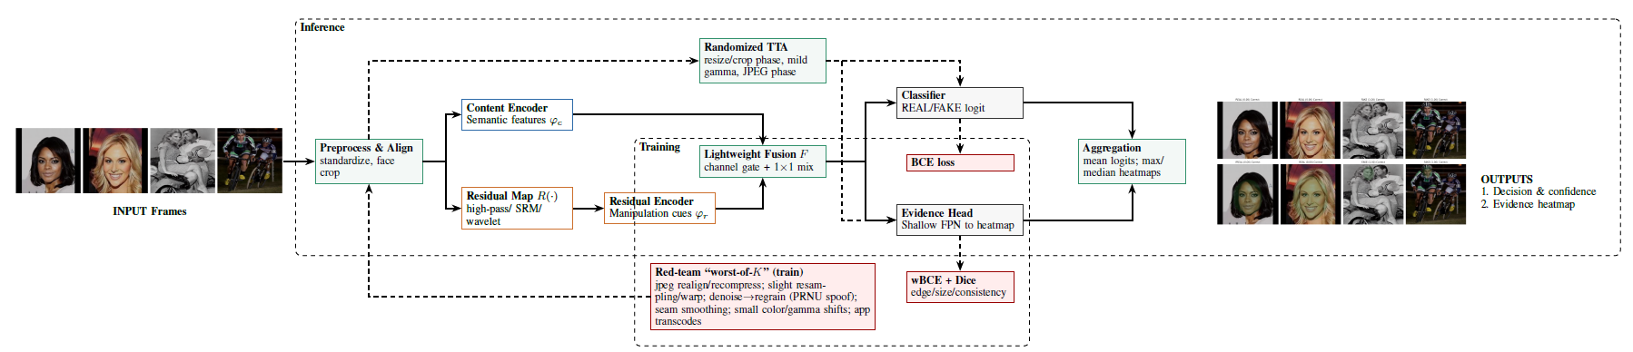
Implementation & Inference
PyTorch, mixed precision, fixed seeds; 2 epochs fine‑tune; batch=32; AdamW 1e‑4.
Mask head native 256²; upsampled to input size for loss & overlays.
Inference: N=3 TTA jitters; logit average; heatmap max‑pool.

Slide 14
Evaluation Protocol & Metrics
Threshold-free: AUC — Area Under the (ROC) Curve: ranking quality over all thresholds. AP — Average Precision (area under the precision–recall curve).
ACC(τ) — Accuracy at threshold τ (fraction correct after choosing a single decision threshold).
ECE — Expected Calibration Error (average gap between predicted confidence and actual accuracy).
Brier — Brier Score (mean squared error of predicted probabilities vs. labels).
NLL — Negative Log-Likelihood (cross-entropy of predicted probabilities).
AURC — Area Under the Risk–Coverage curve (overall error when allow abstention as coverage decreases).

Slide 15
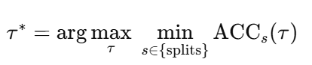
Evaluation Protocol & Metrics
Why a single global τ*
τ* is the single global decision threshold picked on the validation set to work for all conditions (clean + every attack).
Chosen on validation to maximize worst-case accuracy.
Avoids per-attack tuning.

Slide 16
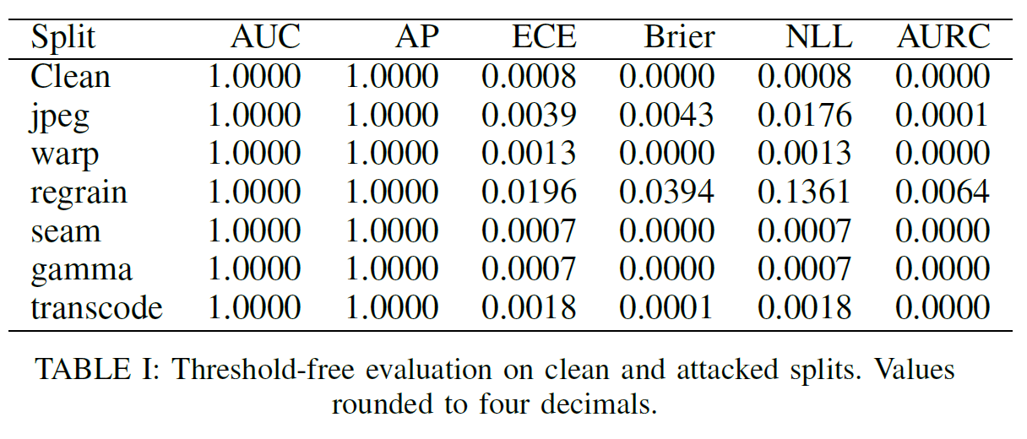
Results
AUC = 1.00, AP = 1.00 on clean & all attacks.
ECE low overall; regrain is the hardest stressor (largest calibration shift).
AURC near zero (low abstention risk).

Slide 17
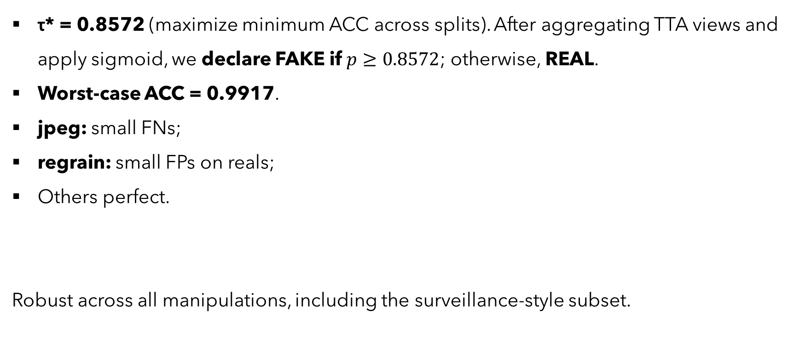
Results: Operating Point & τ*
τ* = 0.8572 (maximize minimum ACC across splits). After aggregating TTA views and apply sigmoid, we declare FAKE if $p≥0.8572$; otherwise, REAL.
Worst‑case ACC = 0.9917.
jpeg: small FNs;
regrain: small FPs on reals;
Others perfect.
Robust across all manipulations, including the surveillance‑style subset.

Slide 18
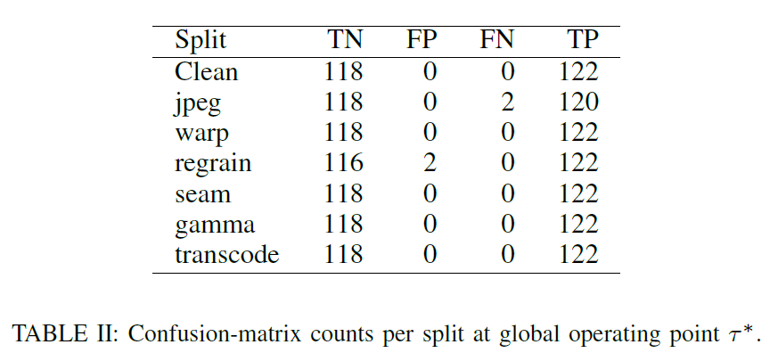

Slide 19
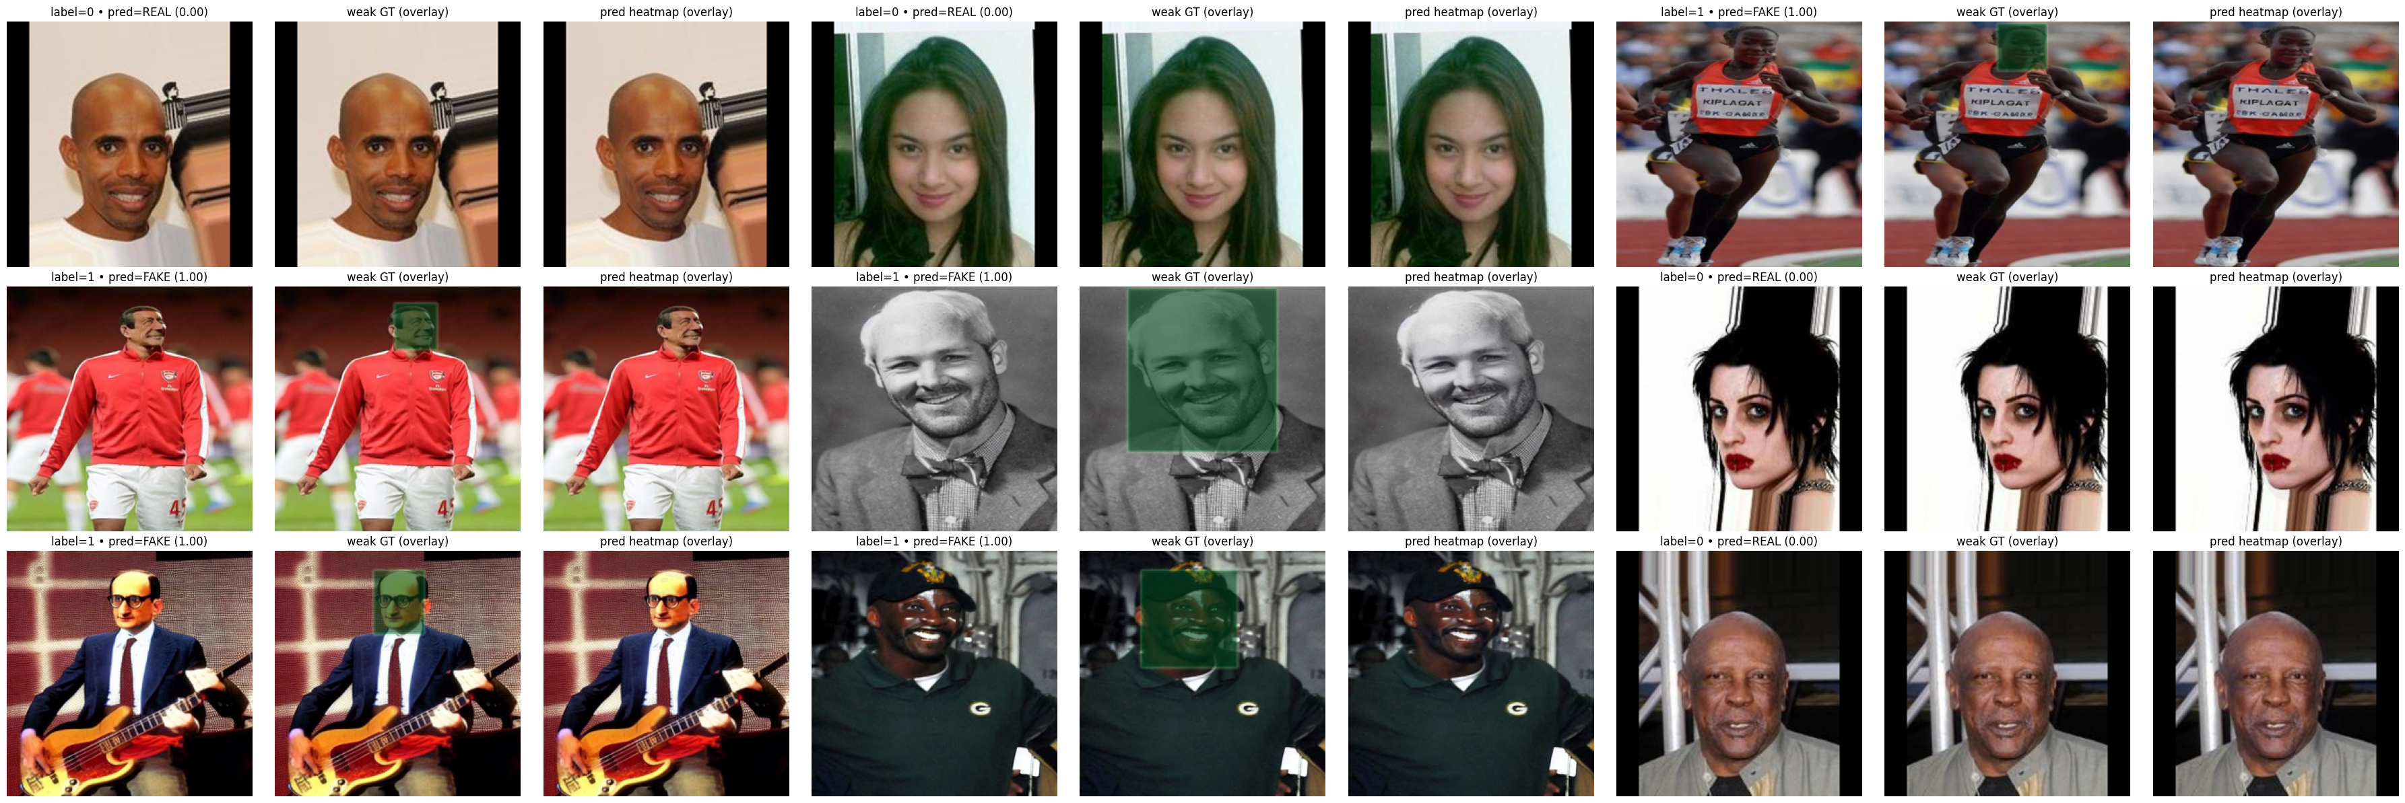
Qualitative: Weak Localization
Real: sparse/diffuse response; Fake: concentrated in face/borders.
Aggregated over TTA views.

Slide 20
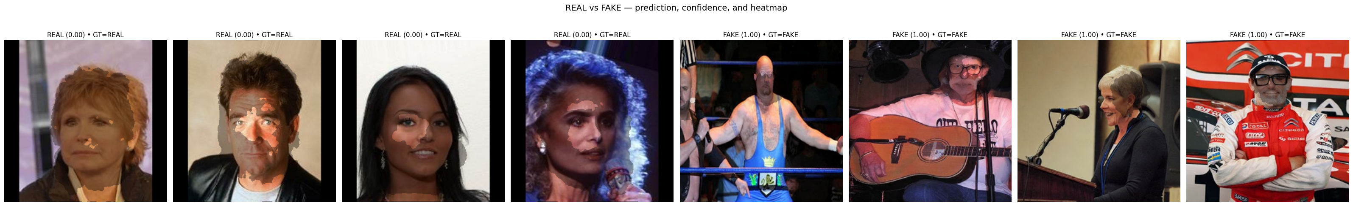
Red‑team training: closes most gaps.
TTA: further reduces calibration error; keeps clean intact.
Weak priors: better energy/precision in ROI; strict IoU ~0 by design
IoU under weak labels is more a measure of annotation granularity than of model capability.

Slide 21
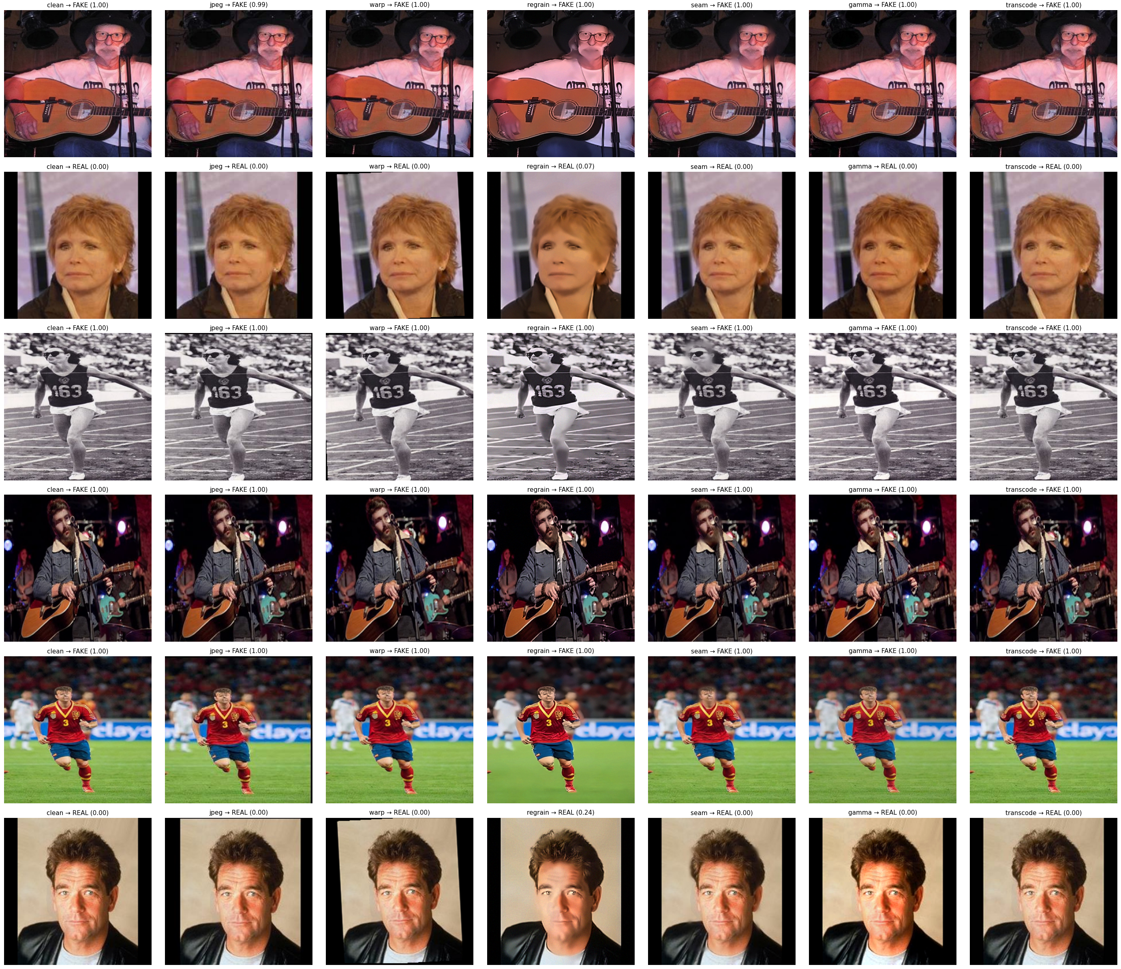

Slide 22
Contributions & Novelty
Unifies worst-of-K training + randomized TTA with two-stream fusion and a weak-supervised FPN head, then scores worst-case behavior and calibration with a single τ*—a combination not reported in prior deepfake forensics.
Worst-of-K red-team training + randomized TTA → stable, attack-aware decisions.
Two-stream content + residual with P2 injection → preserves forensic cues.
Weak-supervised FPN head → useful heatmaps without dense labels.
Deployment metrics (τ*, ECE/NLL/Brier, AURC) → reliability beyond AUC.

Slide 23
Limitations & Future Work
Weak priors ≠ pixel‑accurate masks → hard IoU low.
No guarantees vs fully adaptive adversaries. Image‑only.
Extend priors beyond faces; collect finer‑grained annotations.
Video: temporal aggregation; audio‑visual fusion.
Learned/adaptive counter‑forensics for harder stress tests. Domain adaptation for low‑light/compression.

Slide 24
Thank you

